Slide 1

State Transition Diagram
Year 12

Slide 2
Objectives
use state-transition diagrams to document an algorithm
use state-transition diagrams to show the behaviour of an object

Slide 3
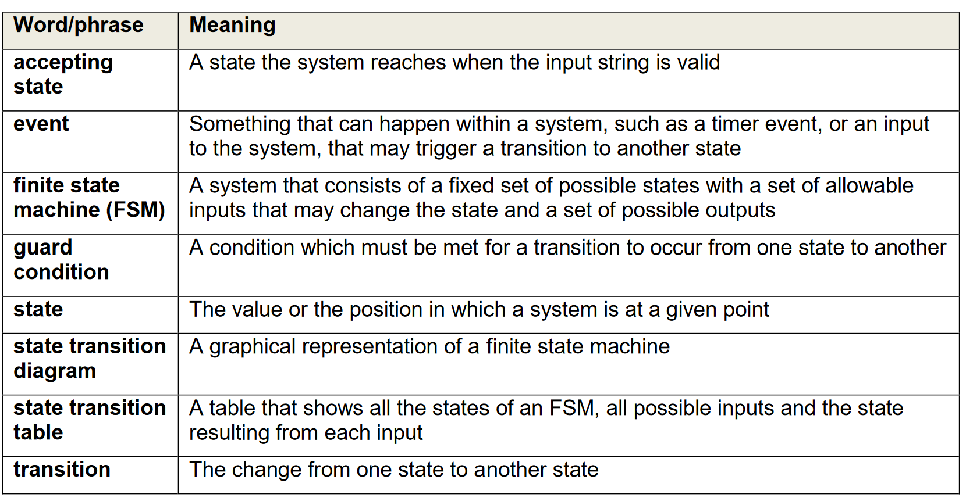
Terms

Slide 4
What are state-transition diagrams?
State- transition diagrams give a visual representation of all the states that a system can have.
the events such as inputs or timers that may result in transition between states, and the transitions between states.
They may also show the conditions needed for an event(s) to cause a transition to occur (the guard condition),
The outputs or actions carried out as the result of a transition
State-transition diagrams are suitable for systems that operate as finite-state machines
These are systems that have a fixed number of different states that may change on an event or input.

Slide 5
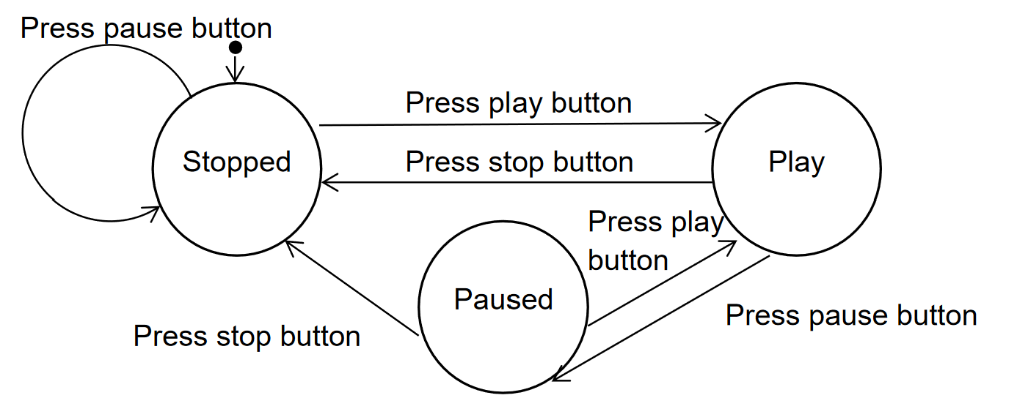
Symbol Used
There are different conventions for state-transition diagrams,
States are normally represented as nodes
transitions as interconnecting arrows
events as labels on the arrows.
Conditions are normally specified in square brackets after the event.
The initial state is indicated by an arrow with a black dot.

Slide 6

Video explanation

Slide 7
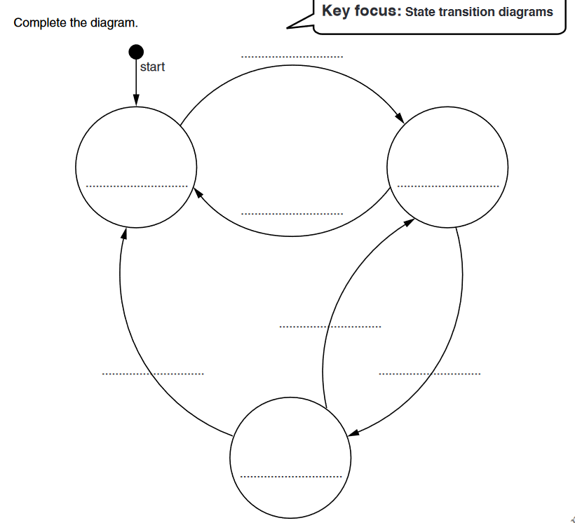
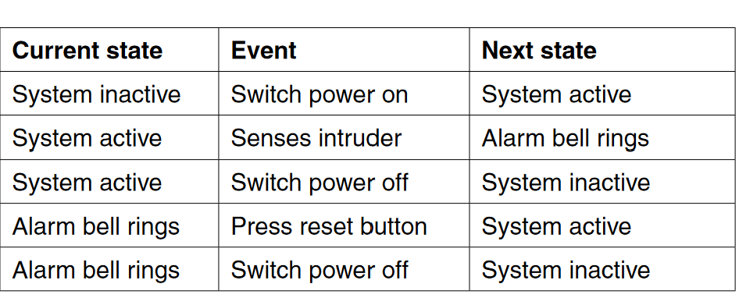
An intruder detection system is inactive when the power is switched off. The system is activated when the power is switched on. When the system senses an intruder the alarm bell rings. A reset button is pressed to turn the alarm bell off and return the system to the active state. The transition from one state to another is as shown in the state transition table below

Slide 8
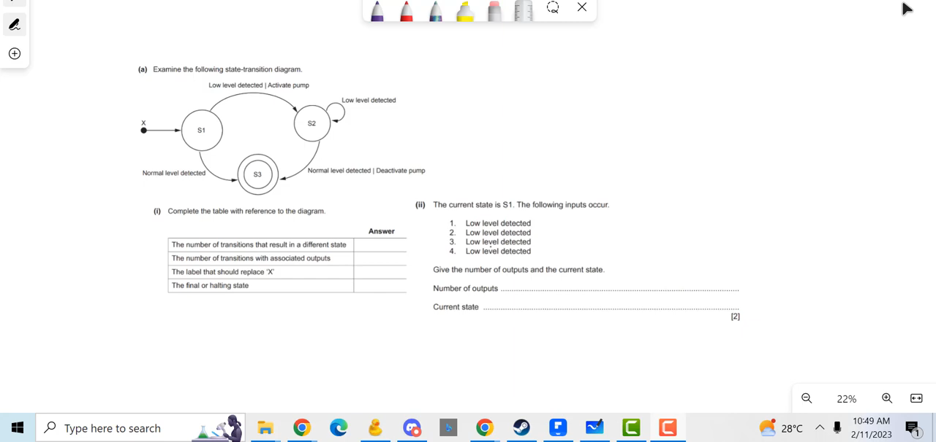
Video Review

Slide 9
Worksheet Questions
Watch the following video and then complete the questions

